Slide 1


DR. Akhilesh Das Gupta Institute of Technology and Management
SNAGNAY++(ONLINE EXAMINATION SYSTEM)
DEPARTMENT OF COMPUTER SCIENCE & ENGINEERING
MAJOR PROJECT PRESENTATION
UNDER THE GUIDANCE OF
DR.SHIPRA VARSHNEY
PRESENTED BY :
SAMAR GUPTA(40396202718)
CHETAN SINGH KARKI (00996202718)
OSHEEN (00296207219)
DATE : 13-06-2022

Slide 2
DEPARTMENT OF COMPUTER SCIENCE AND ENGINEERING
VISION
To produce socially responsible technocrats, researchers , and entrepreneurs in the field of computer science and engineering.
MISSION
M1 -To provide quality education in the field of computer science and engineering with emphasis on research and innovations.
M2 - To inculcate professional behaviour , strong ethical values, and leadership skills.
M3 - To provide a platform for promoting entrepreneurship and multidisciplinary activities.

Slide 3
OBJECTIVE
Snagnay++ is a technology-driven way to simplify examination activities online. It is basically online examination platform.It aims to build a user-friendly system which makes it easier for the judge as well as the participants to create a healthy and secure environment for online education schema.
Candidates can appear for the exam using any desktop, laptop, or mobile device with a browser. Exam results can be generated instantly for the objective type of exam.It can simplify overall examination management and result in generation activity.
It aims to achieve a less or no glitches examination system i.e, because it is names Snagnay (snag means glitches and nay means no).
It conduct exam effortless, the functionality of snagnay++ software such as user friendly dashboard, detailed reporting, give feedback option, automatic instant results help in smooth conduction.
It reduce exam anxiety amongst test takers as they can take exam any time of the day that preffered sleep/wake cycle and also take exam at specific exam date time.
It reduce administrative burden , organizing and running exams online not only reduce an organization’s administrative burden but also save cost and time. Online examination with its objective to make evaluation massive but simple, cost effective and faster has replace the pen paper-based assessment.

Slide 4
Introduction
Snagnay++ is a way to convert traditional pen and paper-based exams to online and paperless mode.
It uses the process of invigilating an online test from any location to eliminate any unwanted student behaviour.
Students must confirm their identity and they monitored through video.
It support objective and subjective type of exam.
It provide flexible examination environment so that the students can choose any time slots in a specific window – this avoids any inconvenience and enables test-givers to give the examination when fully prepared.

Slide 5
Methodology
Online examination system (Snagnay++) saves the exams information in a database, teachers (or
admins) can add/delete questions, set the correct answers, specify the exam period, register
students, delete students, show questions for students randomly, calculate and show the final
results for students.
) System design
Online Examination System (Snagnay++) is a web-based application system used to create and
evaluate examination. This system architecture consists of 3 sections: - frontend, backend and
database server. For the design of the system we used interpreted programming language
Python, client-side Ajax techniques, in order to send and retrieve data from the server, CSS for
the styling of web pages and the relational database management system MySQL. The whole
system is divided into three modules: administrator module, teacher and student module.

Slide 6
Methodology
B. ) Database Design
In order to fully use MySQL server technology, it is essential to make sure that the database is well designed or we can use SQLite which is provided by python itself . The files names chosen to label all the tables created within the database attempt to reflect the table’s purpose and, therefore , contribute to well-design system . The intimal step in designing was to decide, according to the requirements and specifications of the project , which tables should be created, and what type of information each one should hold.

Slide 7
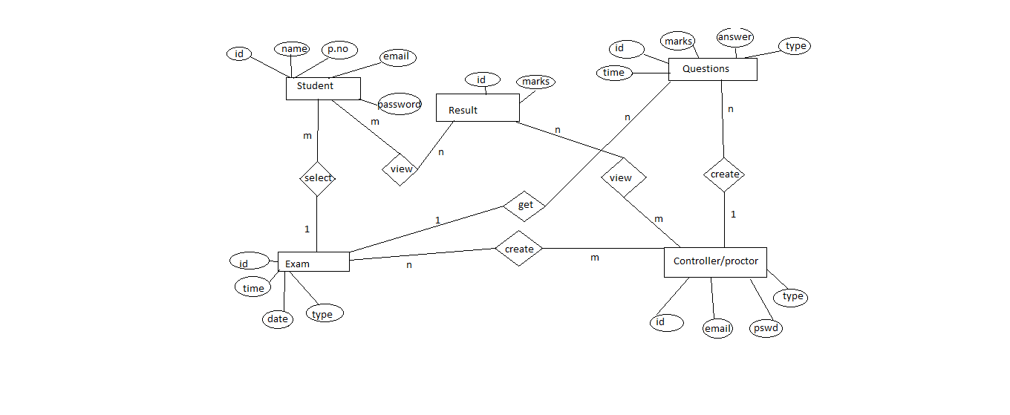
ER DIAGRAM
Fig 1 : ER Diagram for Snagnay

Slide 8
From these ER Diagrams we can know the functionality which we are going to achieve.
Our Model Will includes the facility of Admin,Teacher and Student,Contact the admin.
ADMIN: The admin can control the execution of the whole system where he/she can add courses , can modify teachers and students data according to use.
TEACHER: The teacher can register and use SNAgNAy to take exams and give the instant results by adding courses and questions .
STUDENT: The Student can take exams and get the marks instantly and can know about the courses he/she is enrolled into etc.
CONTACT :In case of any glitch or issue one can immediately mail/dial numbers to get hassle free solution.
Security:
The Login panel achieves this by using validation of ID and Passwords.
The additional feauture of OTP verificaiton is cherry on cake.
Additionally the machines learning face recognition , voice recognition etc .will be there to recognise the right student and teacher to enter into the Examination System.
Later on More Security features will be there like gaze tracking, video monitoring , etc.

Slide 9
NAture of project
SOFTWARE | HARDWARE
Windows XP and others | Processor: Atleast Pentium 2.0 and above
visual studio code | Ram: 2Gb or More
Google Chrome , Mozill Firefox | Hard Disk: 20Gb Free Space or More
SQLite

Slide 10
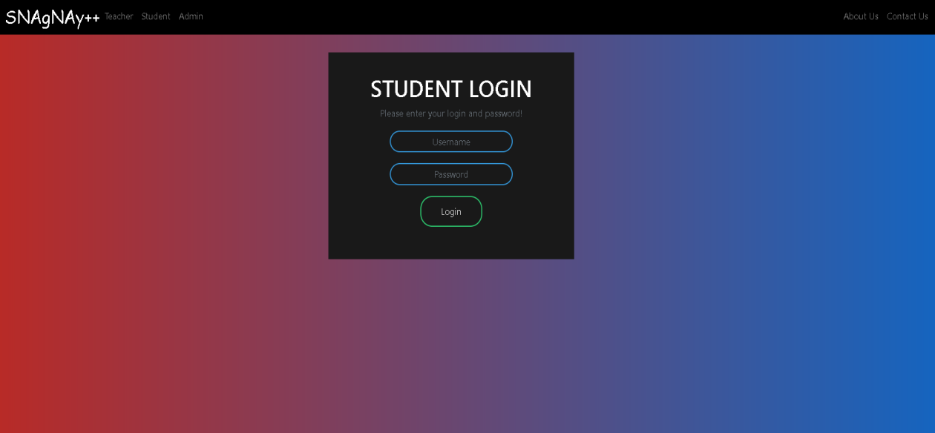
RESULT Screenshots
LOGIN PAGE
Fig 2 : Login page

Slide 11
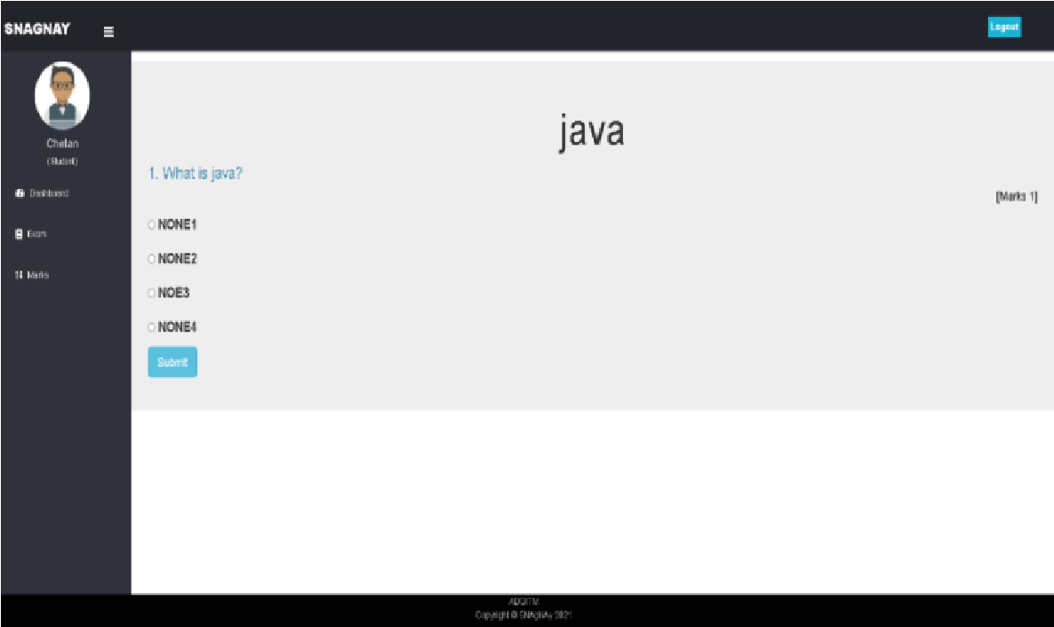
exAM pAGE
Fig 3 : Exam Page

Slide 12
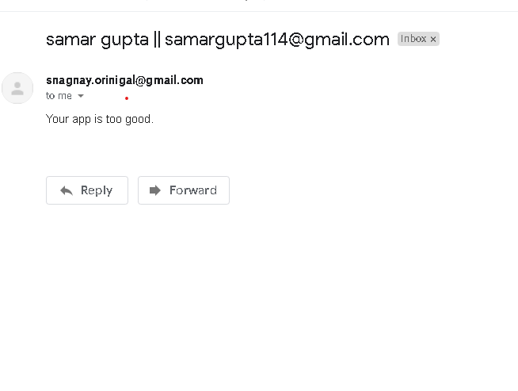
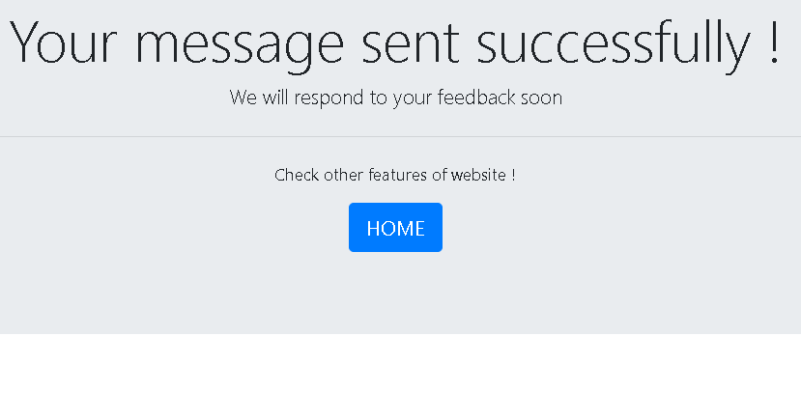
feedback PAGE
Fig 4 : Feedback

Slide 13
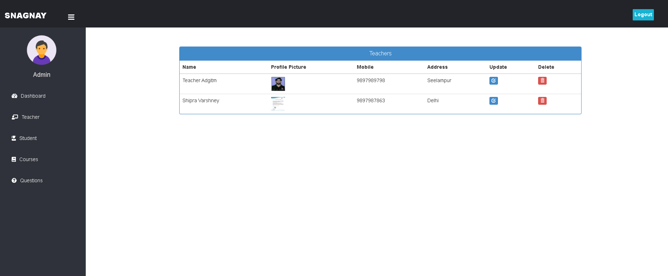
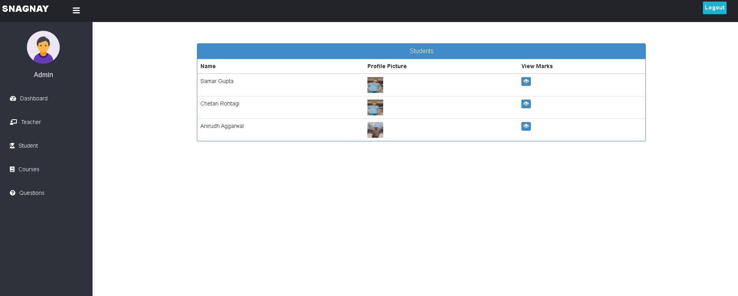
teacHERS AND STUDENTS PROFILE
Fig 5 : Teachers and Student Profile

Slide 14
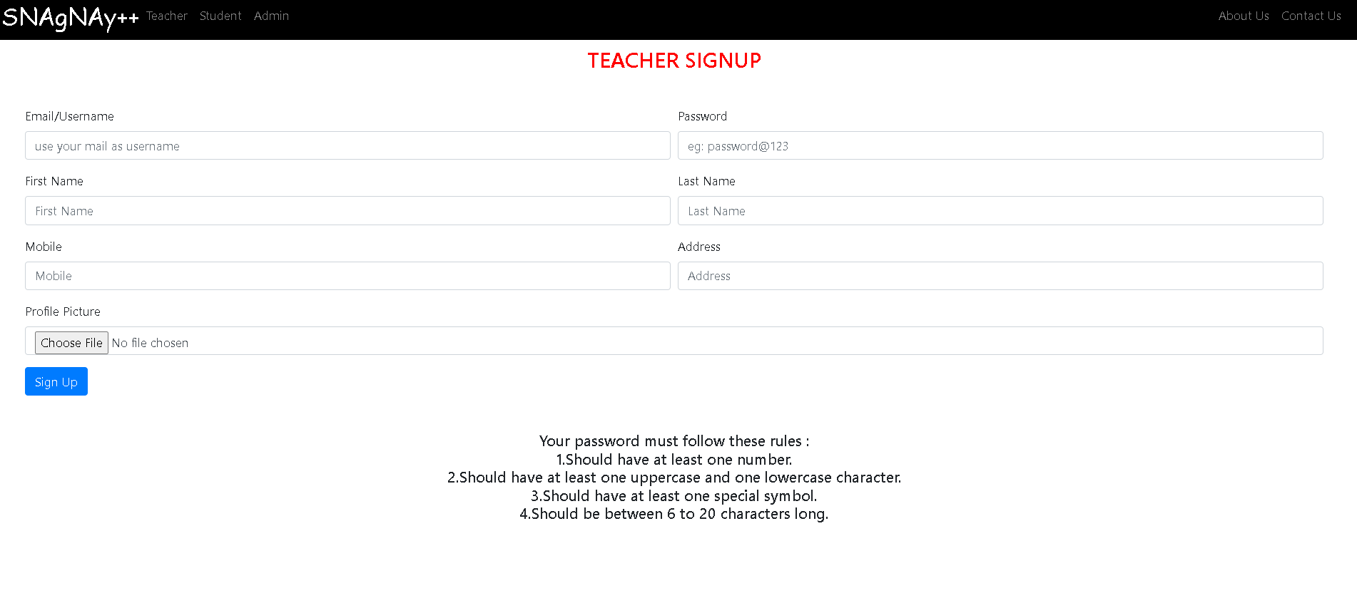
tEACHER sIGHUP PAGE
Fig 6 : Teacher SignUp page

Slide 15
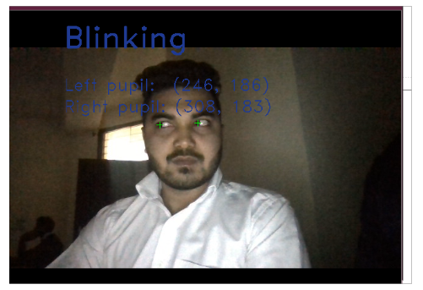
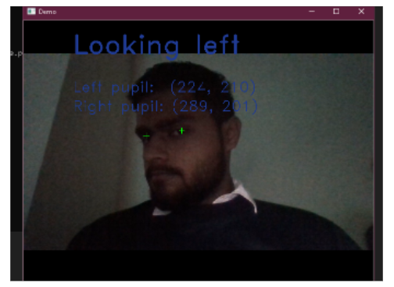
GAZE TRACKING
Fig 7 : Gaze Tracking Feature

Slide 16
Reference papers
[1] Exam Conduction and Proctoring System Using Face Detection ; IJSREM International Journal of Scientific Research in Engineering and Management Issues ,Vol . 06 ,Issue 1,No 1 ,ISSN : 2582-3930 .January 2022
[2] A web-based online examination system for computer science education ; International Journal of Scientific & Engineering Research Volume 9, Issue 7, ISSN : 2229-5518 , (July-2018 ).
[3] Challenges of Online Exam, Performances and problems for Online University Exam; IJCSI International Journal of Computer Science Issues, Vol. 10, Issue 1, No 1,ISSN (Print):1694-0784—ISSN(Online):1694-0814.(January2013) www.IJCSI.org
[4] B.Persis Urbana Ivy,A.shalini, A.Yamuna :WebBased online Secured Exam/International Journal of Engineering Research and Applications (IJERA) ISSN:2248-9622 www.ijera.com Vol. 2, Issue 1, (Jan-Feb 2012) , pp.943-944943.
[5] Li Yueru,” Algorithmic Online Examination System Design”, FuJian computer. 2009,1:66-67.
[6] K. D. Rajab, "The Effectiveness and Potential of E-Learning in War Zones: An Empirical Comparison of Face-To-Face and Online Education in Saudi Arabia," IEEE Access, vol. 6, 2018.
[7] A. S. Muharina and B. Kelana, "E-learning preparation estimation on Indonesian understudy from singular viewpoint: A contextual investigation," Proc. - 2017 Int.Conf. Support. Inf. Eng. Technol. SIET 2017, vol. 2018-Janua, pp. 353–357, 2018.
[8] A. Younis, A. Provide food steel, and J. Take off, "Determinants of saw convenience of e-learning frameworks," Computer Human Behaviour, vol. 64, p. 843e858 Contents, 2016.

Slide 17
THANK YOU

